Slide 1
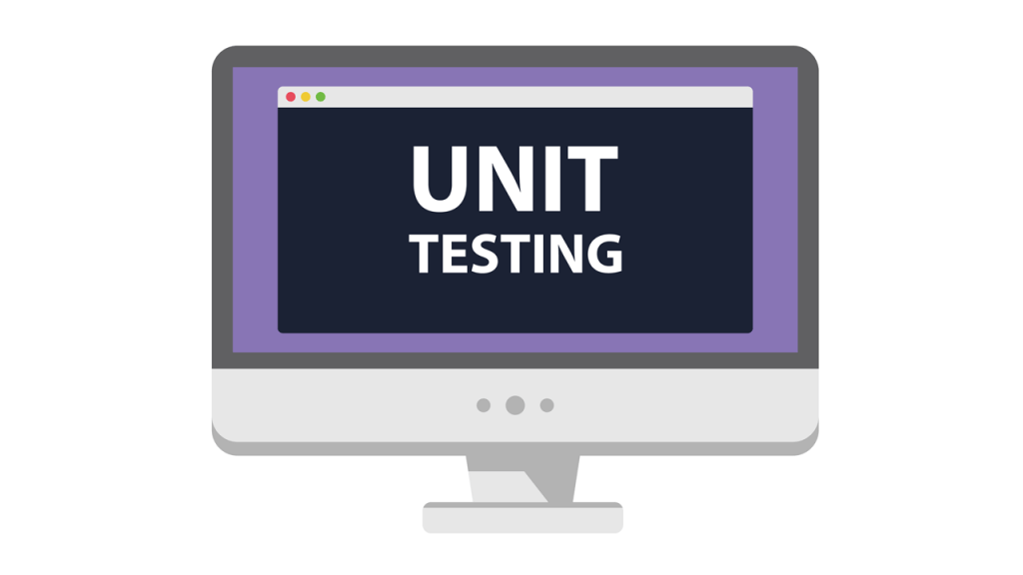

Slide 2
Testing Levels 1. Unit Testing 2. Integration Testing 3. System Testing 4. Acceptance Testing

Slide 3
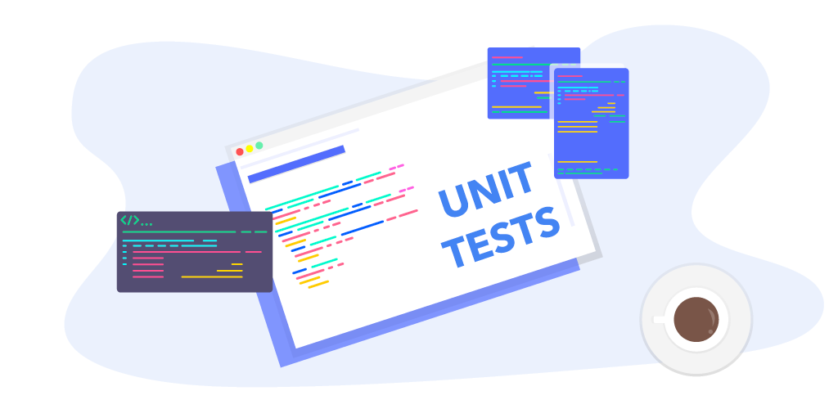
Unit Testing we can say component or module Testing we will be asking 4Q that will describe this level ( what , when , who , why )

Slide 4
What Question what is this level do ? The goal of this level is to test each unit and see if it do the job specified for it or not . Unit is including ( Functions , Reports , Forms , SQL ) .

Slide 5
When Question when does unit testing start ? The unit testing start when the Functions or Modules are coded

Slide 6
Who Question who is responsible for unit testing ? The developer is responsible for the unit testing

Slide 7
Why Question why are we doing unit testing ? Easier to fix bug and picked up earlier Faster debugging Smaller amount of code Reduce future cost

Slide 8
Why Question why are we doing unit testing ? Easier to fix bug and picked up earlier Faster debugging Smaller amount of code Reduce future cost

Slide 9
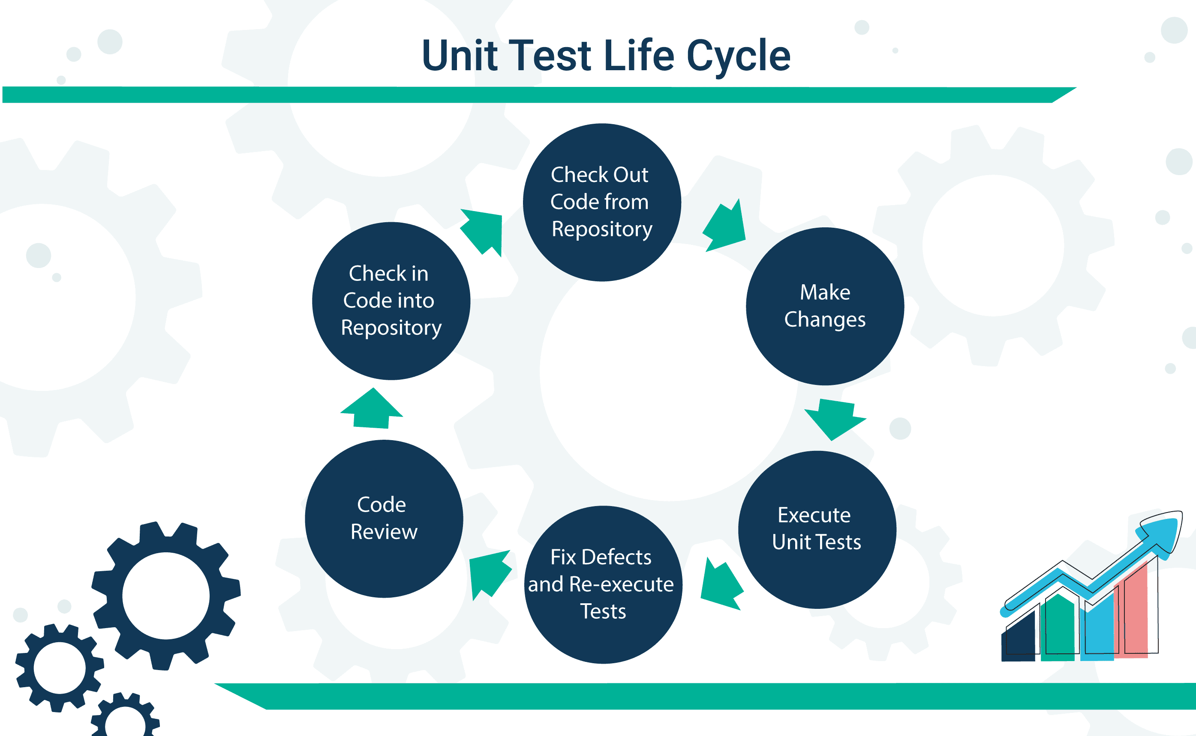

Slide 10

Tool The program that will be Tested is a Calculator program with C++ Therefore, we will use (Code::Blocks) to write the code

Slide 11


Frameworks I will use a visual studio with Googletest Framework to test the C++ program

Slide 12
Techniques Here I will use white box , because I see the code I will use Decision or brunch testing to coverage all statements

Slide 13

Read a,b
Do {}
invalid
SQR
DIVI
MUL
SUB
ADD
READ select!=6
EXIT

Slide 14
Techniques cont.. Here we have 13 Taste Case that coverage the code The happy and bad scenario will be created to test the simple and worst case in the code as user ( in the video of demo )

Slide 15
Video Link https://drive.google.com/file/d/1ANFctwWC65d8SvikiAd9gjlTYTC4m-HK/view?usp=sharing

Slide 16

Thanks

